Slide 1
Fluid Movement in cells
How cells take up nutrients and get rid of waste

Slide 2
The cell membrane
The cell membrane is the natural “gate keeper” around the cell, and controls movement of materials into and out of the cell
The word permeable means “allowing passage” and impermeable means “not allowing passage

Slide 3
The cell membrane
The cell membrane is a Selectively permeable membrane meaning it allows some things passage, and blocks others

Slide 4
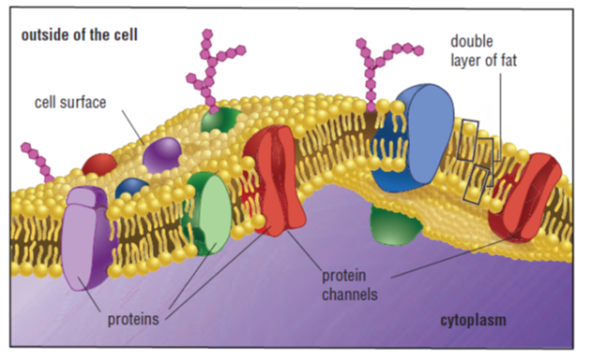
The cell membrane
The cell membrane is made up of 2 layers of fat with proteins embedded in it

Slide 5
The cell membrane
The protein channels vary in size to selectively allow some particles to travel into the cell
Generally, small particles like water, oxygen, and carbon dioxide are allowed in while larger particles like fat and sugar do not easily pass through

Slide 6
Diffusion
Diffusion is the movement of particles from an area of high concentration to an area of low concentration

Slide 7
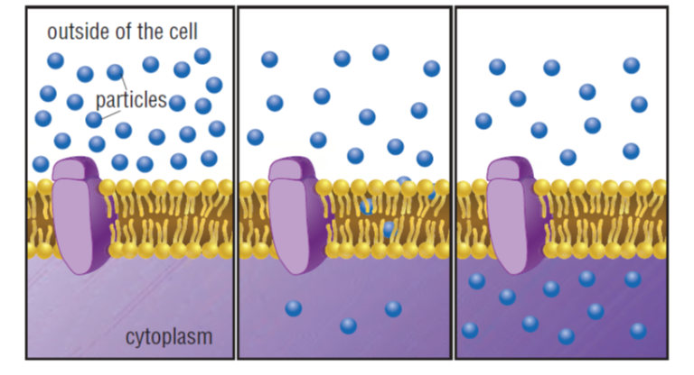
Diffusion
The difference in concentration is called the concentration gradient
Diffusion always occur down the gradient (from an area where they are more concentrated to a less concentrated area)

Slide 8
Diffusion
Diffusion plays an important role in how living things obtain energy and get rid of wastes
In living things, the intake of nutrients from food and the removal of wastes occur at the cellular level
This requires that particles cross the cell membrane

Slide 9
Diffusion
When the substance diffusing across the cell is water, it is called osmosis
A state of Equilibrium occurs when there is an equal concentration of solute on both sides of the membrane

Slide 10
Diffusion in your body
Example: oxygen in blood
Blood vessels, called capillaries, that are located in your muscles carry oxygen-rich blood cells to your muscle cells
The oxygen then diffuses from the blood cells into your muscles
The muscles use the oxygen to create energy

Slide 11
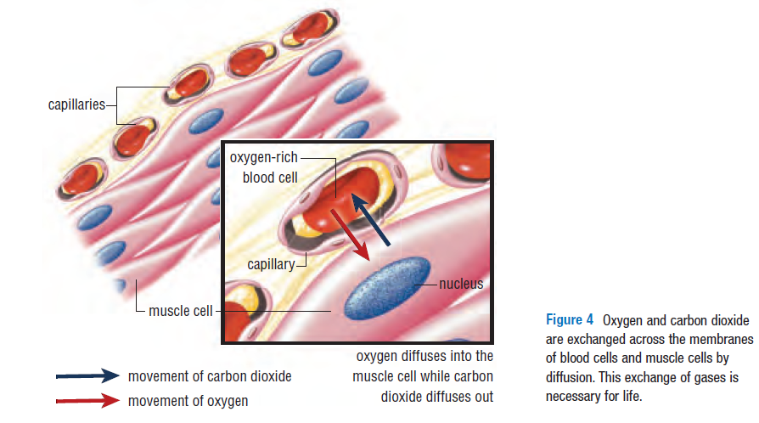
Oxygen diffuses from blood cells (where it is high in concentration) to the muscle cells where it is in low concentration.
Once the oxygen is inside the cell, it is used to make energy, so this keeps concentration of oxygen inside the cell less than that outside the cell, so diffusion can continue
At the same time, waste (carbon dioxide) is produced inside the cell and diffuses across the membrane

